Slide 1
Endothrix
Author: Prasanthi Kolli
Citation: Prasanthi Kolli. 2015. Endothrix.
Publication Date: August 2015

Slide 2
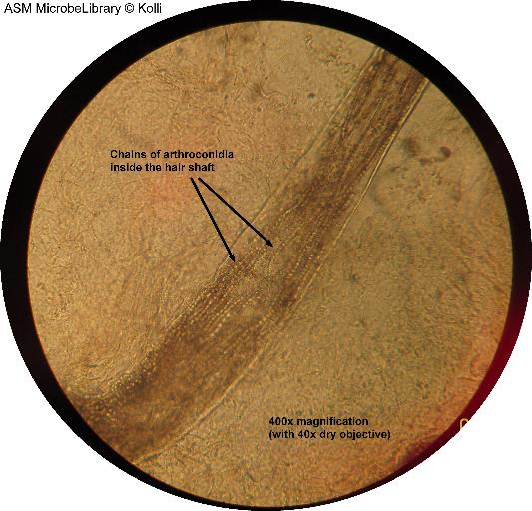
Endothrix Potassium hydroxide (10%) preparation of the hair shaft showing chains of arthroconidia (fungal spores) characteristic of endothrix (indicated by arrow) (400x magnification).
American Society For Microbiology ©

