Slide 1
Decarboxylase Broth
Author: Multiple Authors
Citation: Multiple Authors. 2015. Decarboxylase broth.
Publication Date: September 2015

Slide 2
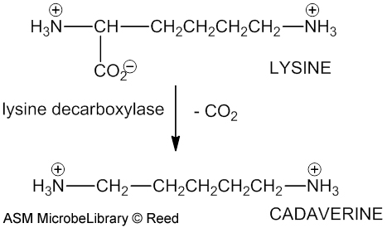
Lysine Decarboxylation
The carboxyl group in lysine is removed by lysine decarboxylase yielding cadaverine. (Norman Reed, Thompson Rivers University, Kamloops, British Columbia, Canada)
American Society For Microbiology ©

Slide 3
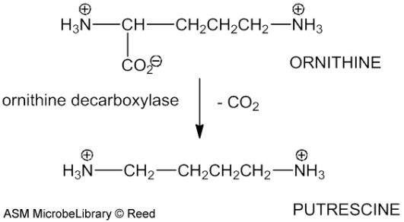
Ornithine Decarboxylation Ornithine is decarboxylated by ornithine decarboxylase giving rise to putrescine. (Norman Reed, Thompson Rivers University, Kamloops, British Columbia, Canada)
American Society For Microbiology ©

Slide 4
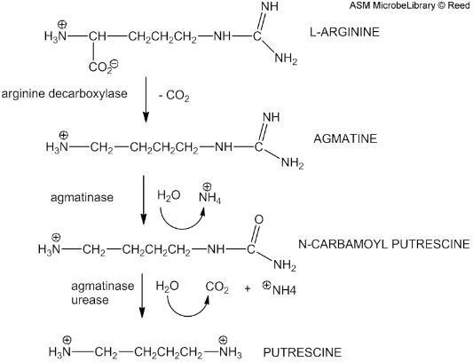
Arginine Decarboxylation and Deamination Arginine decarboxylation requires a combination of decarboxylase and dihydrolase to achieve the complete decarboxylation of arginine to putrescine. Arginine decarboxylase decarboxylates the amino acid arginine into agmatine. (Norman Reed, Thompson Rivers University, Kamloops, British Columbia, Canada)
American Society For Microbiology ©

Slide 5
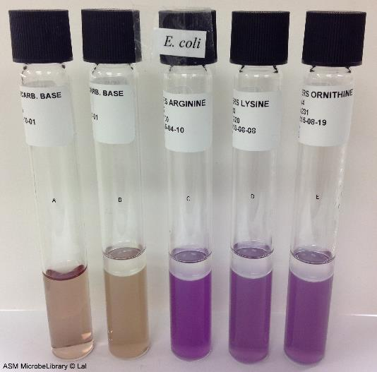
Moeller’s Decarboxylase media Moeller’s Decarboxylase media: A: Uninoculated base, B: Base inoculated with E. coli, C: Arginine broth inoculated with E. coli, D: Lysine broth inoculated with E. coli, E: Ornithine broth inoculated with E. coli. Purple color in tubes C, D, and E indicate that this strain of E. coli is arginine, lysine, and ornithine decarboxylase positive. (Archana Lal, Independence Community College, Independence, KS)
American Society For Microbiology ©

Slide 6
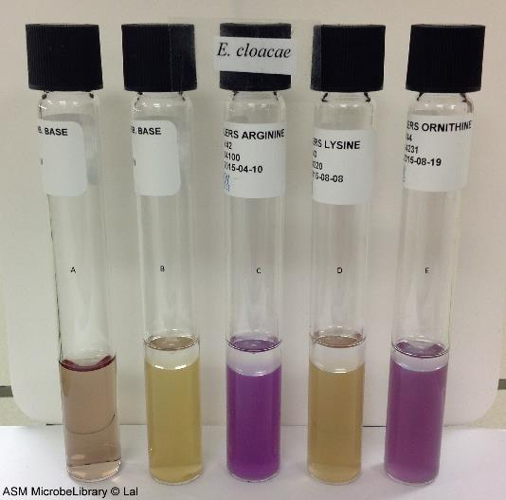
Moeller’s Decarboxylase media Moeller’s Decarboxylase media: A: Uninoculated base, B: Base inoculated with Enterobacter cloacae, C: Arginine broth inoculated with E. cloacae, D: Lysine broth inoculated with E. cloacae, E: Ornithine broth inoculated with E. cloacae. Purple color in tubes C and E indicate that E. cloacae is arginine and ornithine decarboxylase positive while yellow color in tube D (absence of purple color) indicates that it is lysine decarboxylase negative. (Archana Lal, Independence Community College, Independence, KS)
American Society For Microbiology ©

Slide 7
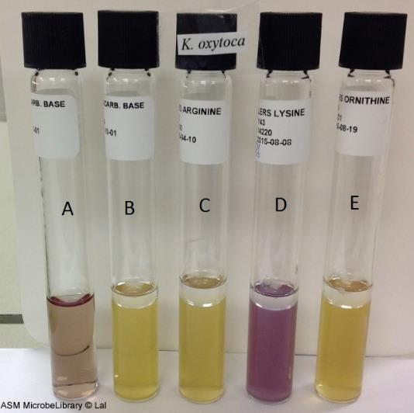
Moeller’s Decarboxylase media Moeller’s Decarboxylase media: A: Uninoculated base, B: Base inoculated with Klebsiella oxytoca, C: Arginine broth inoculated with K. oxytoca, D: Lysine broth inoculated with K. oxytoca, E: Ornithine broth inoculated with K. oxytoca. Purple color in tube D indicates that K. oxytoca is lysine decarboxylase positive while yellow color in tubes C and E (absence of purple color) indicates that it is arginine and ornithine decarboxylase negative. (Archana Lal, Independence Community College, Independence, KS)
American Society For Microbiology ©

Slide 8
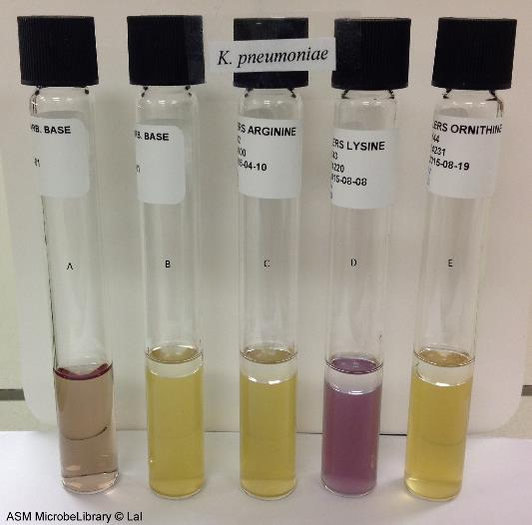
Moeller’s Decarboxylase media Moeller’s Decarboxylase media: A: Uninoculated base, B: Base inoculated with Klebsiella pneumoniae, C: Arginine broth inoculated with K. pneumoniae, D: Lysinebroth inoculated with K. pneumoniae, E: Ornithine broth inoculated with K. pneumoniae. Purple color in tube D indicates that K. pneumoniae is lysine decarboxylase positive while yellow color in tubes C and E (absence of purple color) indicates that it is arginine and ornithine decarboxylase negative. (Archana Lal, Independence Community College, Independence, KS)
American Society For Microbiology ©

